Slide 1
Thriller: Anatomy of a Genre
John P. Morse

Slide 2
Introduction
The Genre
The Inciting Incident
Plotting Strategies
Setting / Raising the Stakes
Suspense
Characters – carrying the story through action, dialogue, and relationships

Slide 3
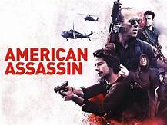
Thriller Genre- the BIG TENT
Representative Archetypes
National Security - Vince Flynn
Psychological - Paula Hawkins
Action - Lee Child
Crime - Michael Connolly
Military - Tom Clancy
Political - Nelson DeMille
Mystery - Ruth Ware
Spy - Daniel Silva
Legal - John Grisham
Sci-Fi - Michael Crichton

Slide 4
The Inciting Incident
Set the Stage
Define the timeframe
Describe the playing field
Light the Fuse
Introduce the Protagonist
Introduce the Bad Guy(s)
Use a Prompt to Hook the Reader. Make them turn the page to Chapter 2.
All the Above in the First Ten Pages!

Slide 5
Plotting Strategies
Pantser or Plotter?
HIP- Hook, Intensity, Prompt
Obstacles, Complications, Struggle, REPEAT
Branches and Sequels: where could it go?
Distractions, Box Canyons, Red Herrings, Broken Confidences
Characters “Out of Character”

Slide 6
Setting/ Raising the Stakes
What’s at Stake?
A kitten’s life or 100,000 lives
Mother, Lover, Aunt Lily, Baby Conner
Money, Fame, Fortune
Trust
Democracy
Security
How to Raise the Stakes?
Unexpected Incident
Expert Predictions
Impossible Odds
Local…Regional…Worldwide

Slide 7
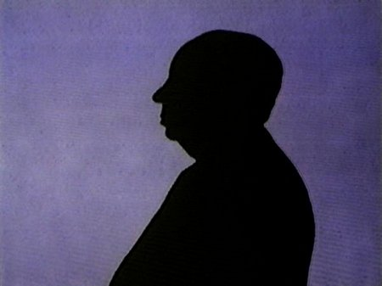
Building the Suspense
Racing Against the Clock
Getting to the next telephone booth
Countdown Timer already started
Light vs Dark
Stimulate All the Senses
Pedal to the Metal
No Holds Barred
Clear the Stage of All the Extras: Mano a Mano
Listen to TCHAIKOVSKY’s 1812 OVERTURE
NB: Beware the Deus Ex Machina - Euripides

Slide 8
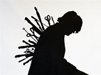
Characters
Protagonist (Perfect 10? Flawed hero? James Bond or Jack Reacher?)
Bad Guy with Redeeming Qualities (Killer with a Robin Hood heart)
Motives: Confused, Secret, Diabolical
Innocent People Die
Save for Sequel
Make Them All Count

Slide 9
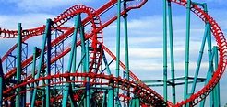
Summary
Fiction is Everyone’s Genre
Edge of the Seat
Page Turning with a Vengeance
Can’t Put It Down
“I Never Felt So Good Losing So Much Sleep”
An Experience: a Roller-Coaster That Goes Forever
Every Great Novel Has Some Thriller in It!

Slide 10
The Secret Word
SPALTED

